Slide 1
Internet Banking
Features & Guideline

Slide 2
Content
Overview
What is iBanking
Features & Functions
Account Management
Payroll
Payroll Bulk
Phone Top Up
Phone Top Up Bulk
Wing Bank to Wing Bank
Wing Bank to Wing Bank Bulk
Wing Wei Luy
Wing Wei Luy Bulk
Wing Wei Luy View Passcode
Wing Bank To World
Wing Bank To World Bulk
Bakong Transfer
Bakong Transfer Bulk
NCS Local Banks
NCS Local Banks Bulk
Billpayment
Billpayment Bulk
Gift Card
Fleet Card
Report
Login & Access Control
Login
Nature of Transfers
Register Receiver
Approval

Slide 3
Overview
iBanking is a secure online platform for transfers, payments, and account management. While available to all customers, it is mainly used by corporate partners to handle high-volume transactions with multi-level approvals.

Slide 4
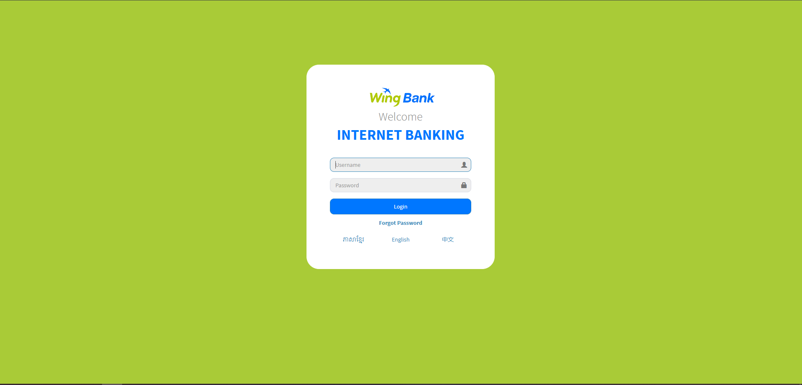
Login

Slide 5
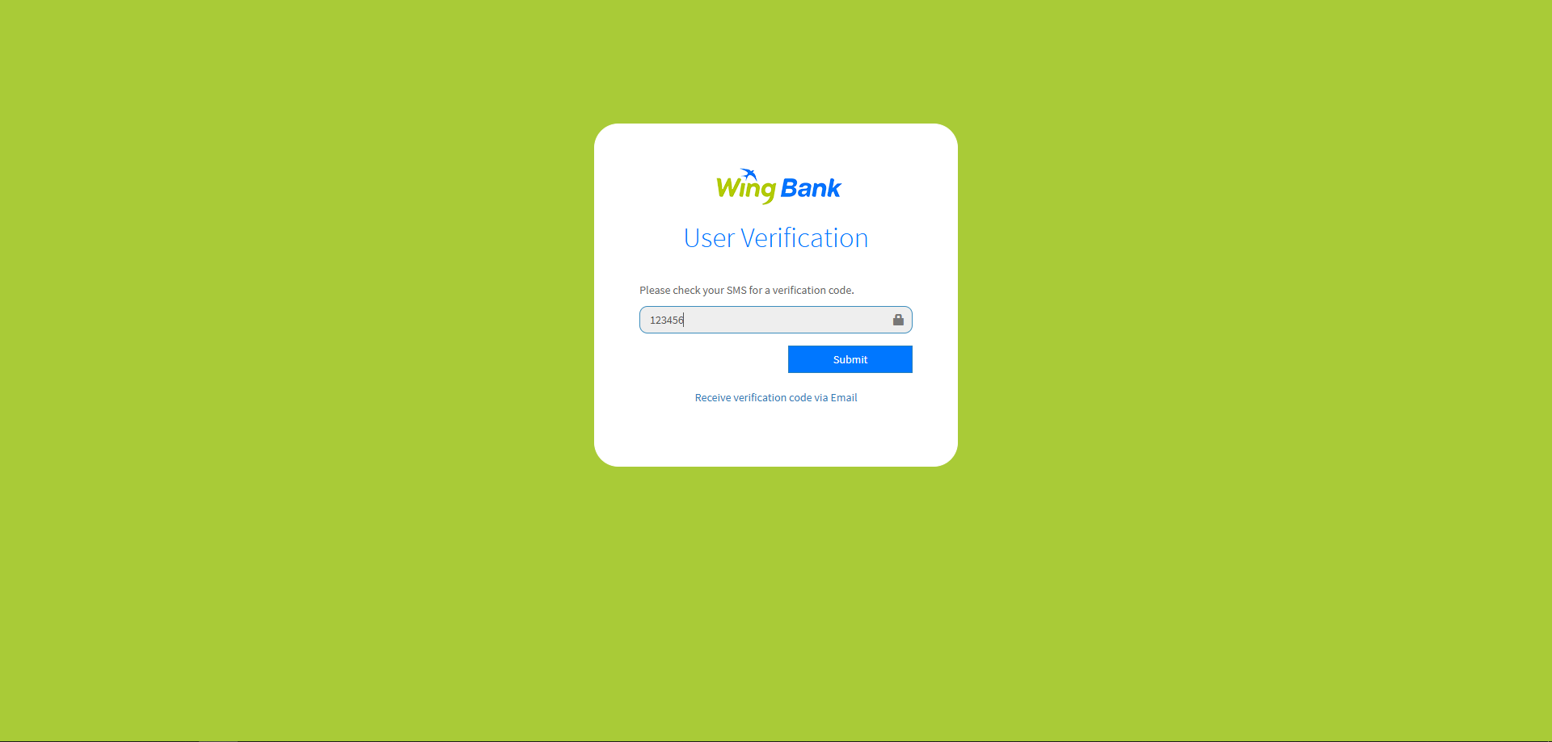
Login

Slide 6
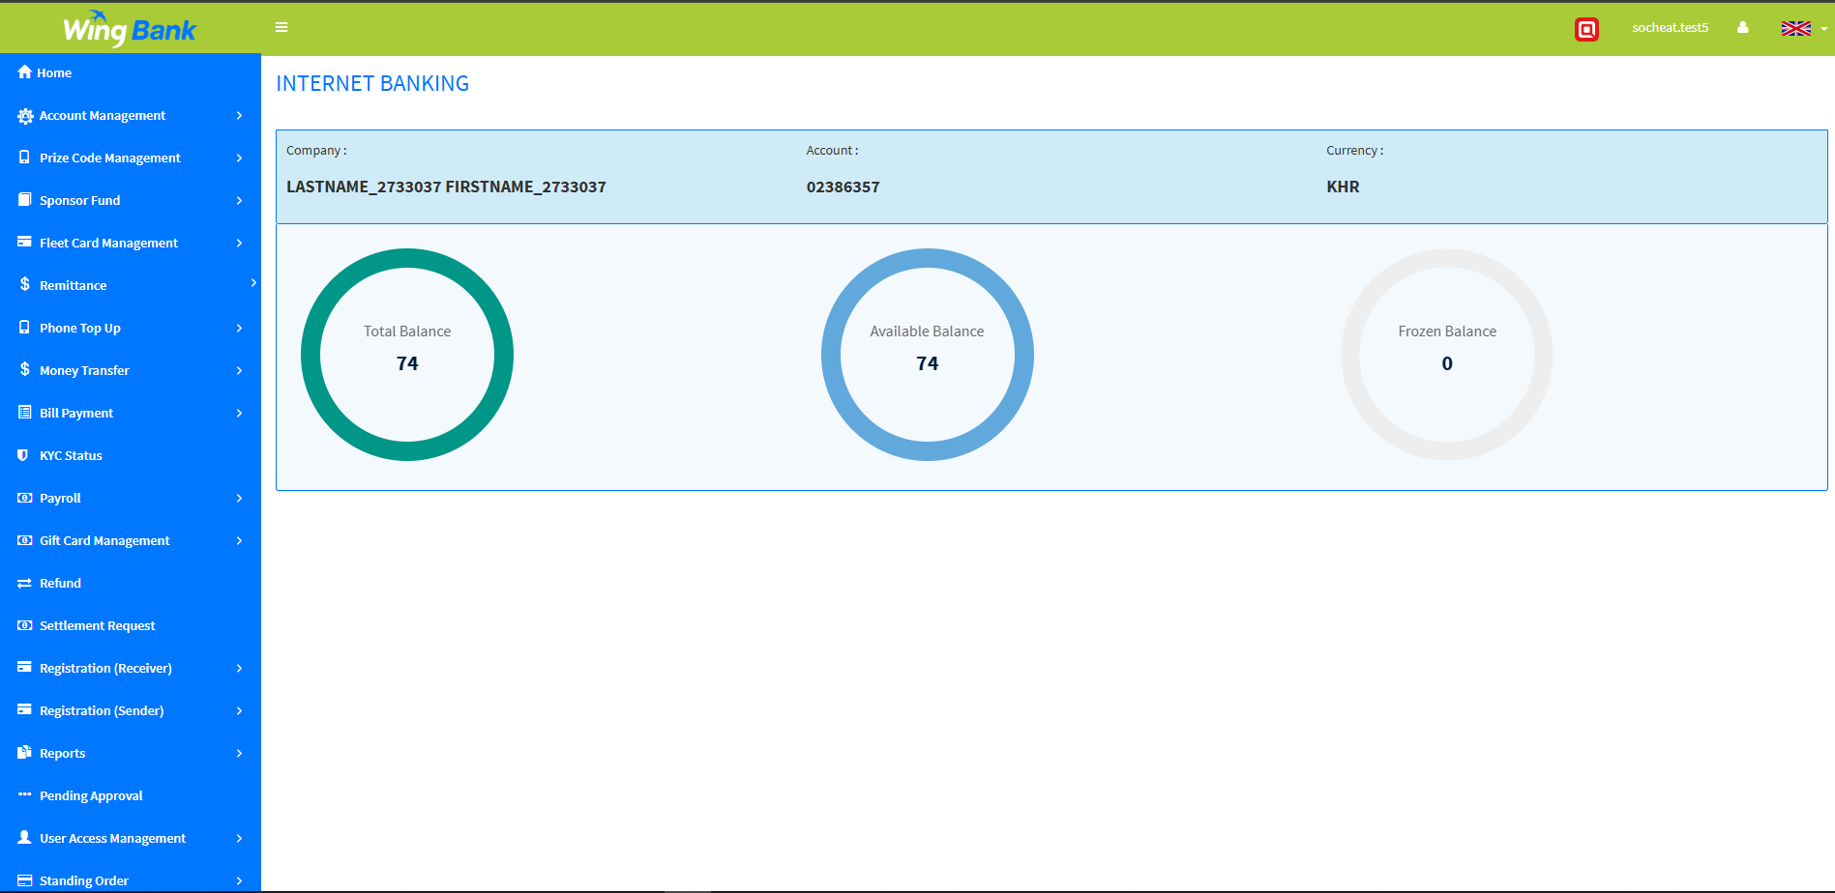
Dashboard

Slide 7
Register Receiver
Register Receiver: To perform transfer services such as Wing to Wing (W2W) and Payroll in iBanking, the receiver must be registered first.
Click on Registration (Receiver) -> Registration Receiver Bulk
Choose Upload File
Click Submit
After review click submit again

Slide 8
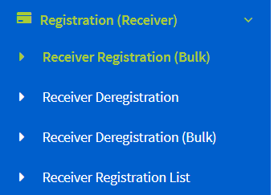
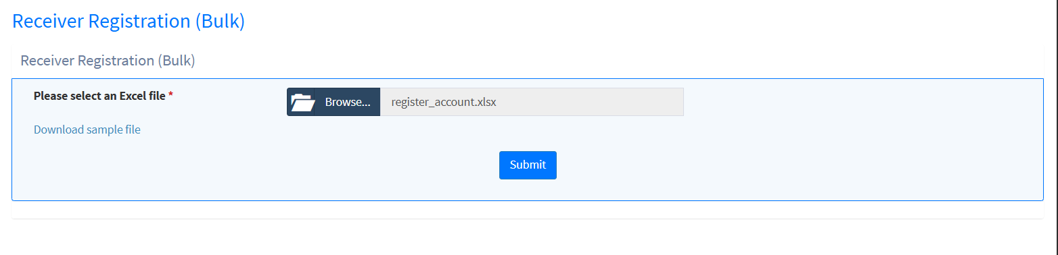
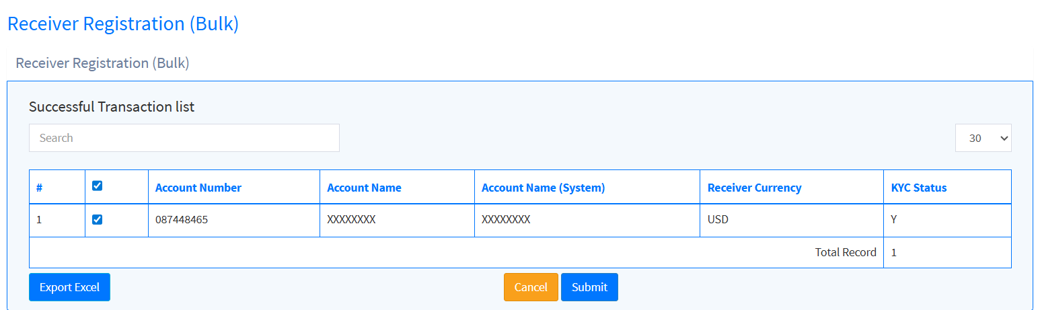
Register Receiver
1
2
3
4

Slide 9
iBanking Transfers: Nature and Approval Process
Approve
Transaction
Pending Approval
Success
User
Reject
End
Approval Type: Normal: required 1 approver
Level 2: required 2 approver
Approval limit: Implemented with a complex matrix (group, rule, level) configured based on service type and transaction amount

Slide 10
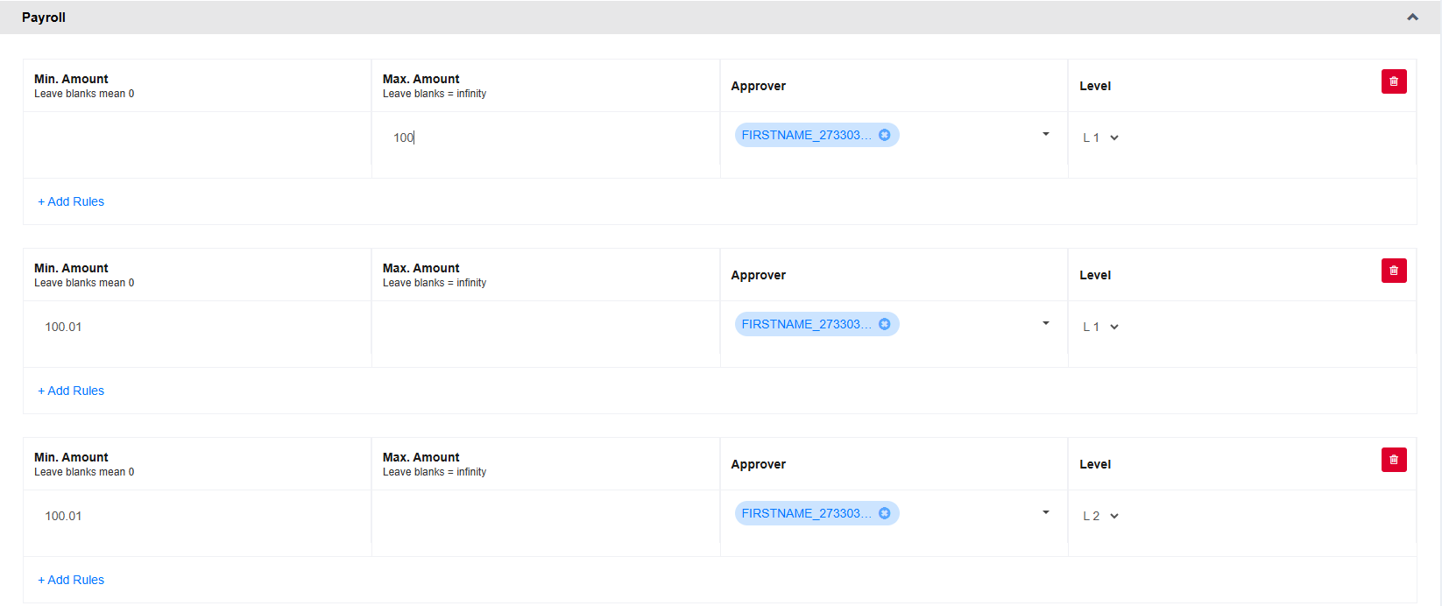
iBanking Transfers: Nature and Approval Process
Example: configuration for pay role service with amount smaller then 100 & amount greater than 100

Slide 11
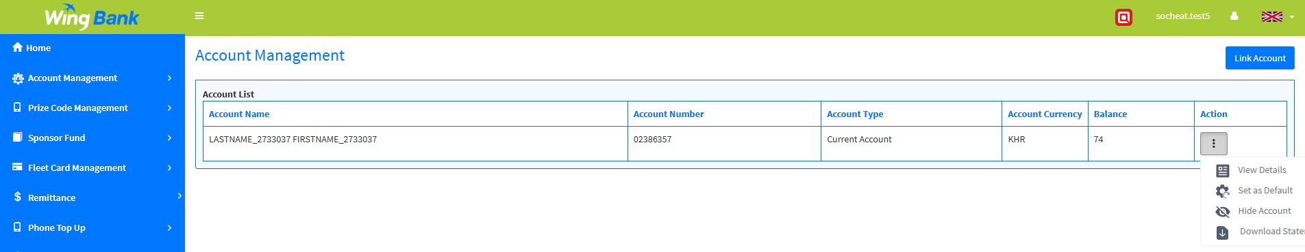
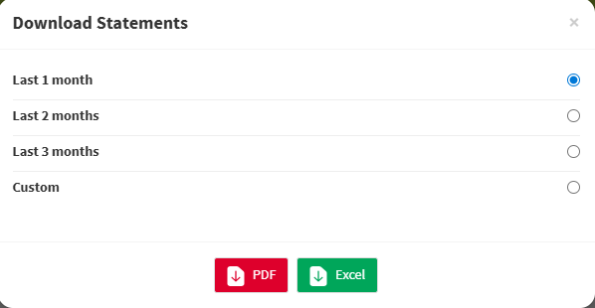
Account Management
1
2
3
4
Download Statement for Viewing Transactions Within a Specified Period
Click on the side menu “Account Management.”
Click on the Action icon.
Select “Download Statement.”
Select period of time and click PDF/Excel

Slide 12
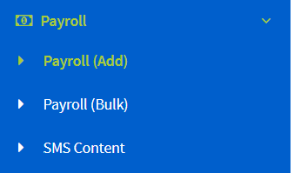
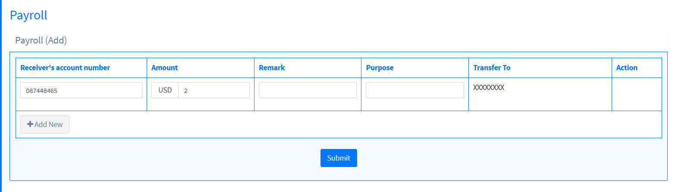
Payroll
Payroll
Click on Payroll -> Payroll(Add)
Enter required data
Click on submit
1
2
3

Slide 13
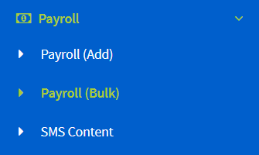
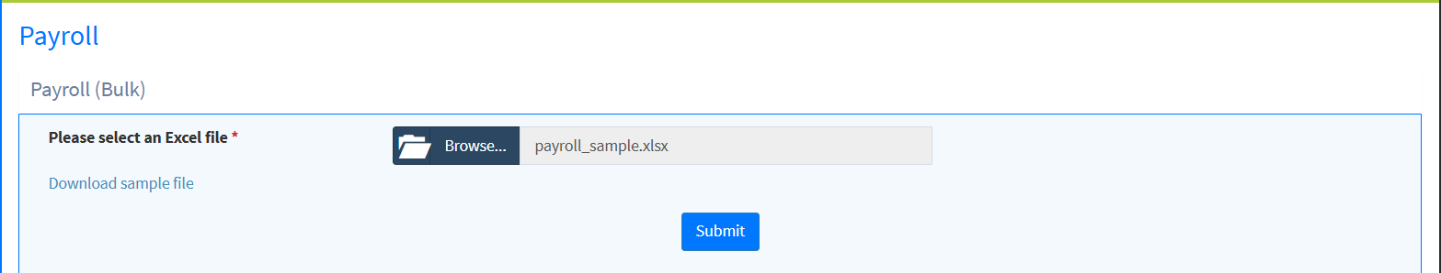
Payroll Bulk
Payroll Bulk
Click on Payroll -> Payroll(Add)
Choose Upload File
Click Submit
After review click submit again
2
1
3

Slide 14
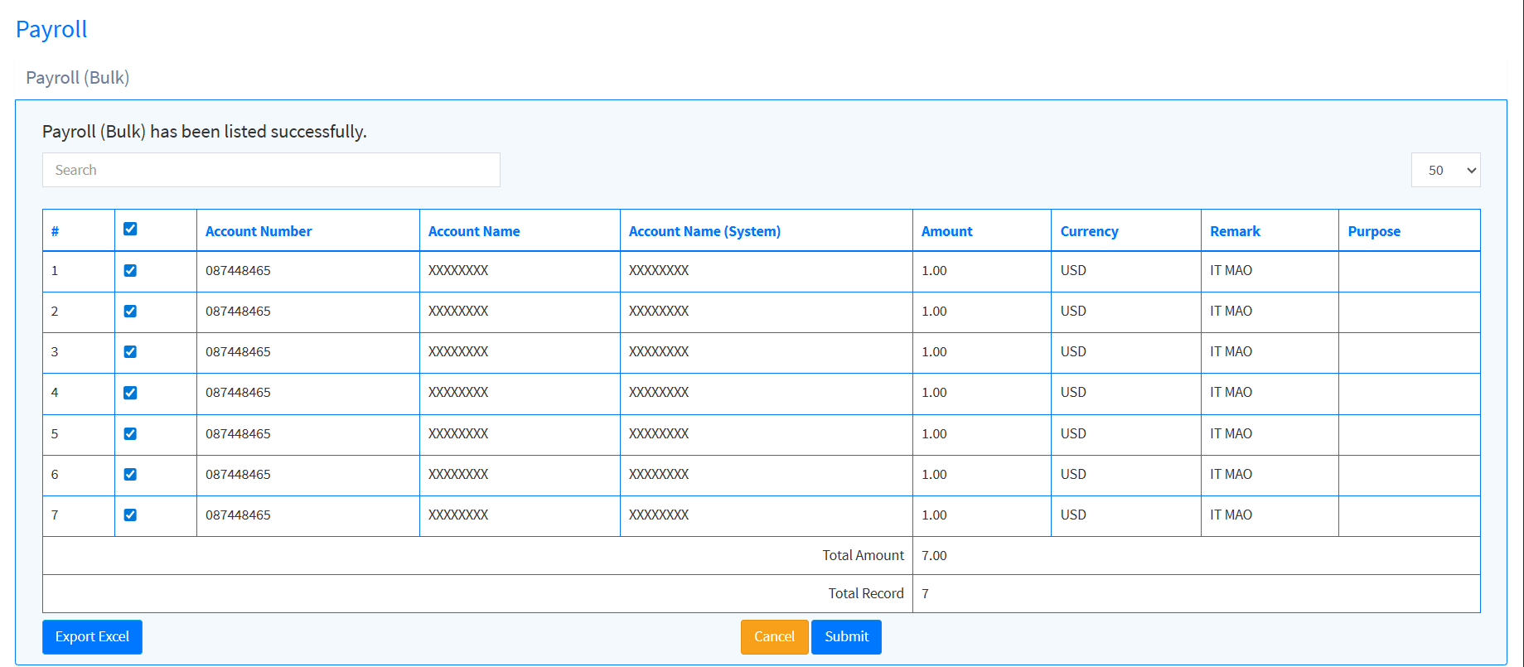
Payroll Bulk
4

Slide 15
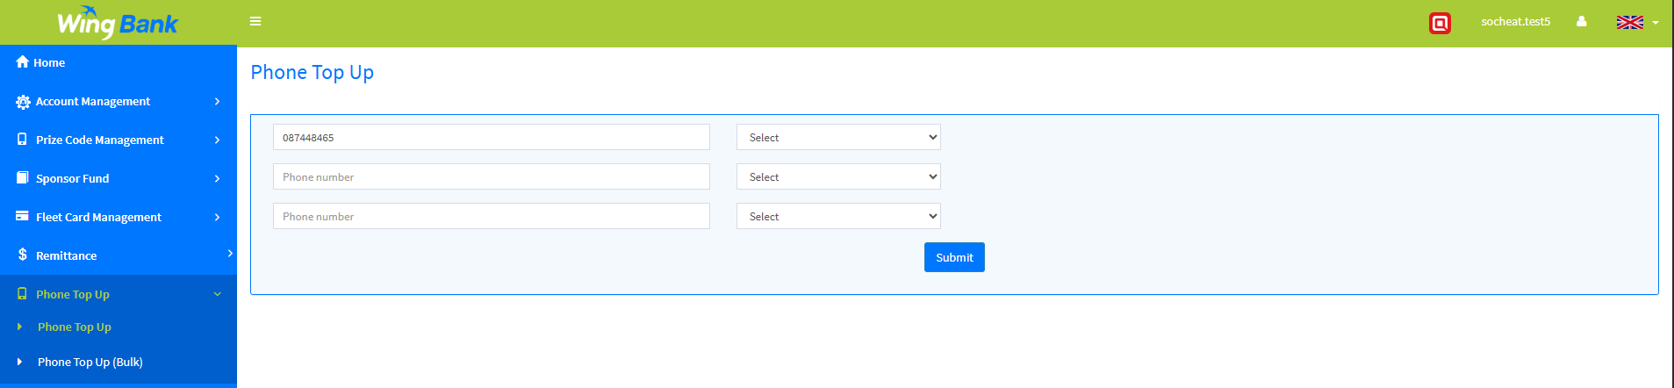
Phone Top Up
2
3
4
1
Phone Top up
Click on the side menu “Phone top up.”
Enter phone number
Select Amount that you want to transfer
Click Submit

Slide 16
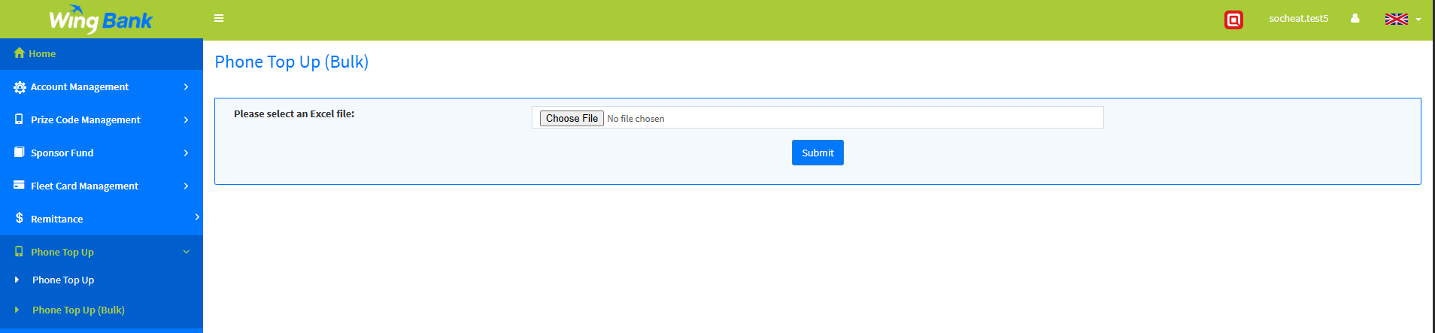
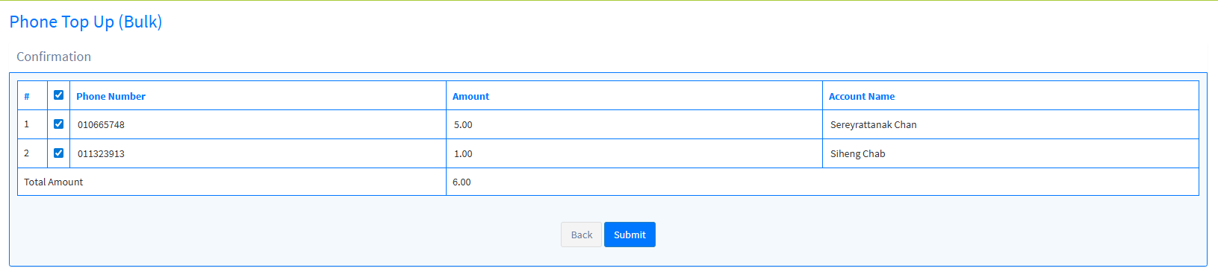
Phone Topup Bulk
4
2
1
Phone Top up
Click the side menu "Phone Top Up (Bulk)"
Choose and upload the file
Click Submit
After reviewing and confirming the details, click Submit again
3

Slide 17
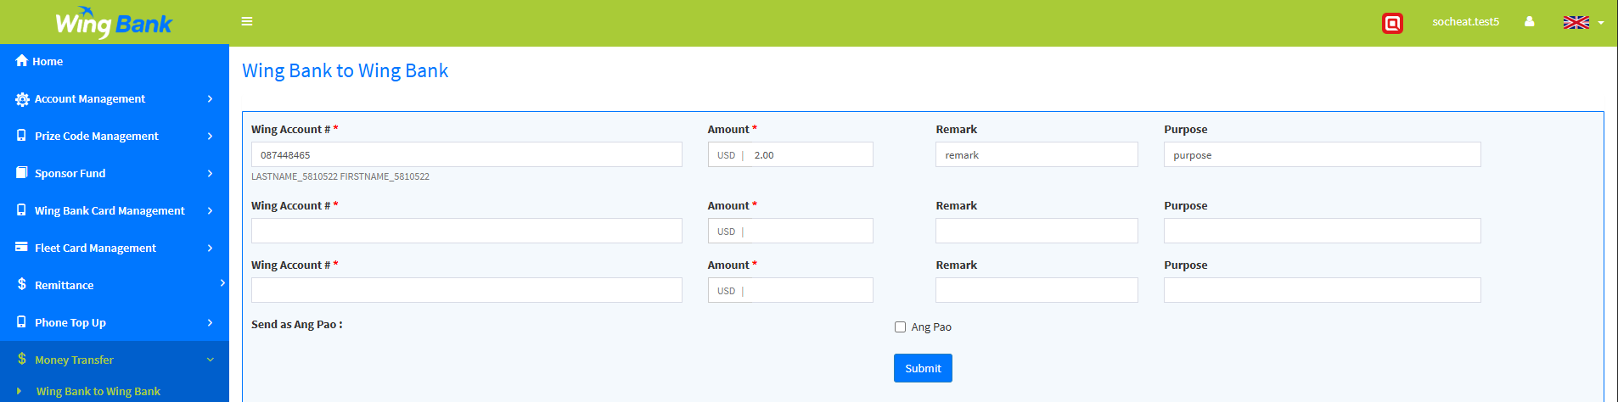
Wing Bank to Wing bank
2
1
3
Wing Bank to Wing Bank
Click on Money Transfer → "Wing Bank to Wing Bank"
Fill in the required fields
Click Submit

Slide 18
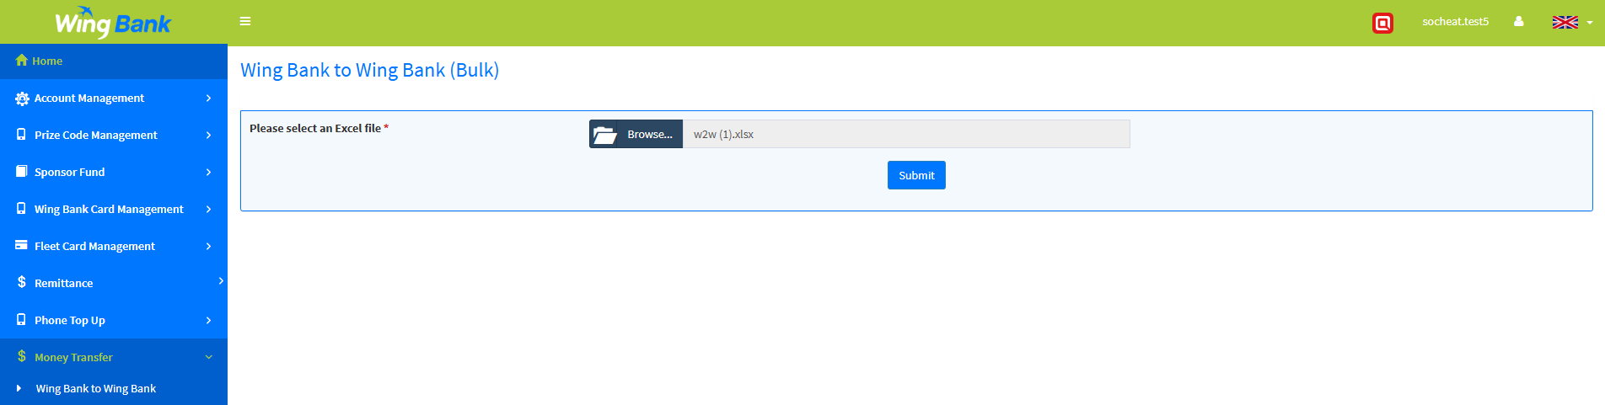
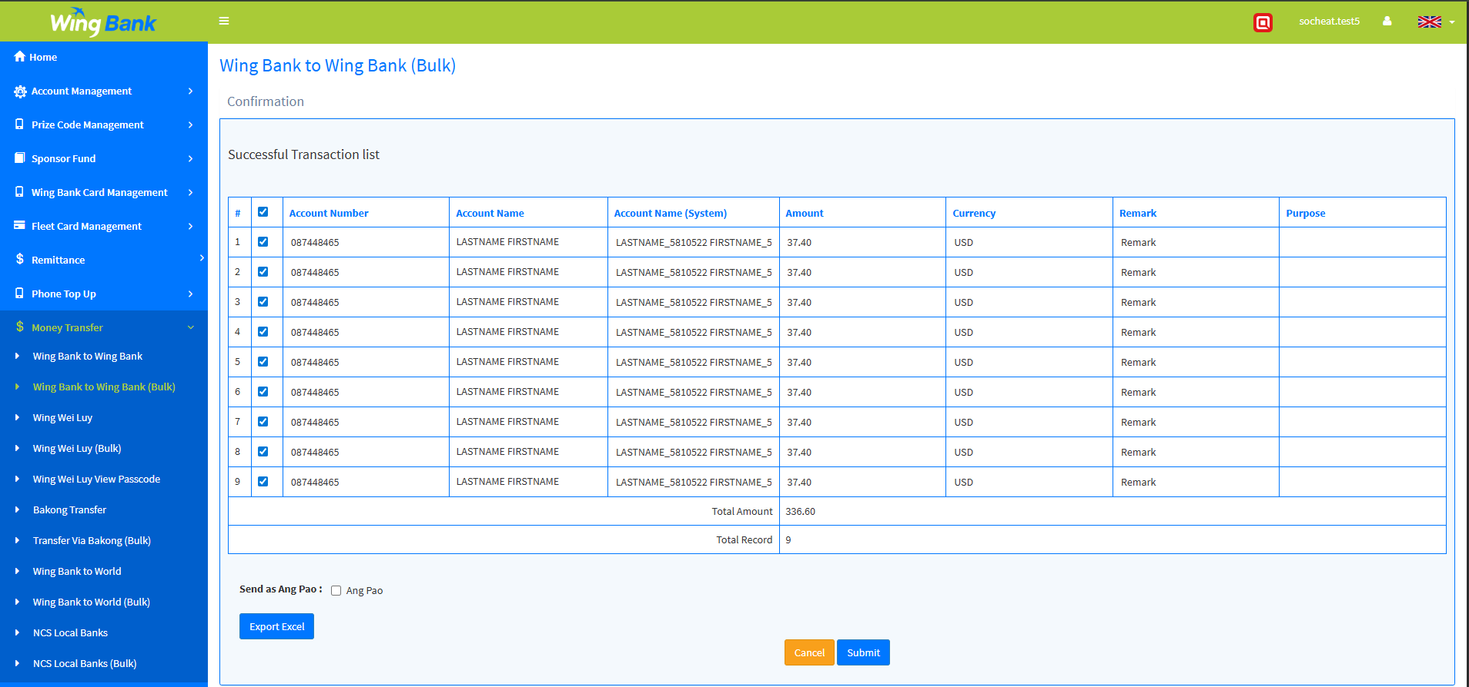
Wing bank to Wing Bank Bulk
4
2
3
1
Wing Bank to Wing Bank Bulk
Click on the side menu “Wing Bank to Wing Bank Bulk
Choose upload file
Click submit
After reviewing Click submit again

Slide 19
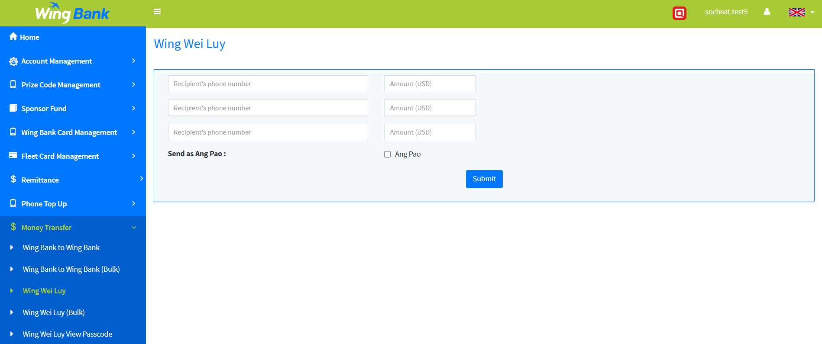
Wing Wei Luy
2
3
Wing Wei Luy
Click on Money transfer -> Wing Wei luy
Enter phone number & amount
Click Submit
1

Slide 20
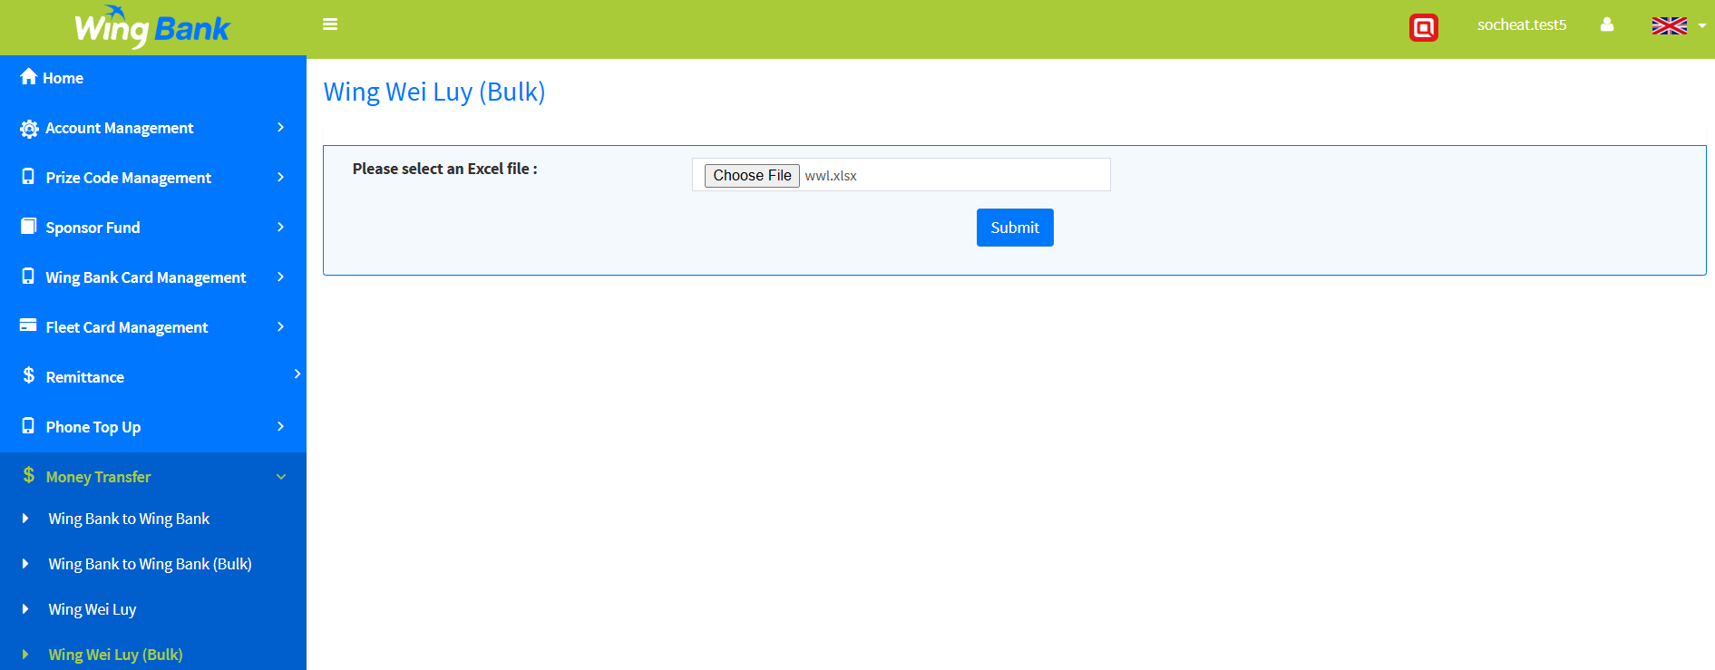
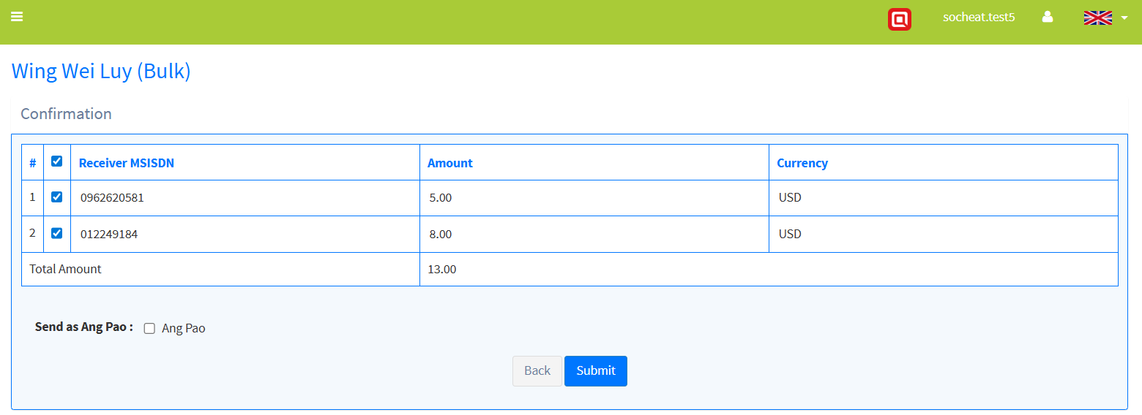
Wing Wei luy Bulk
Wing Wei Luy Bulk
Click on Money transfer -> Wing Wei luy Bulk
Choose Upload File
Click Submit
After review click submit again
2
3
1
4
1
4

Slide 21
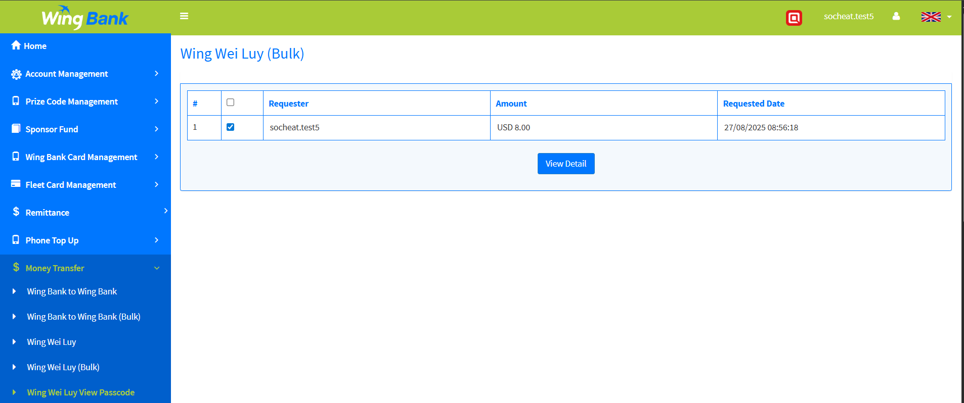
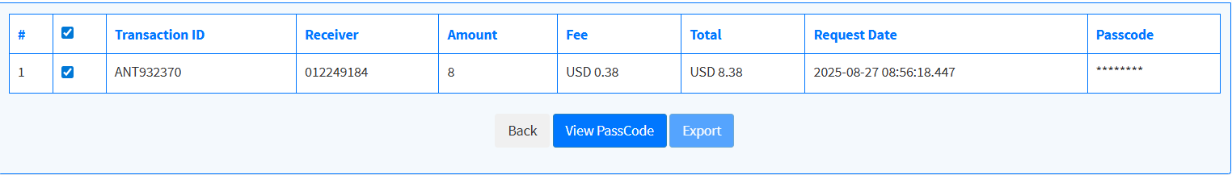
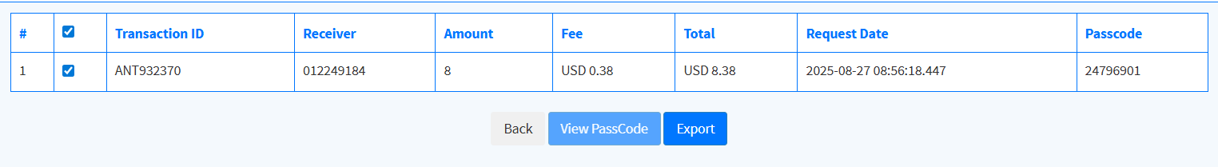
Wing Wei luy View Passcode
View Passcod
Click on Money transfer -> Wing Wei luy View Passcode
Select bulk you wish to view
Click View Detail
After redirecting, tick any record you want to view & click view passcode
2
3
1
4

Slide 22
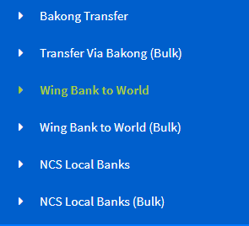
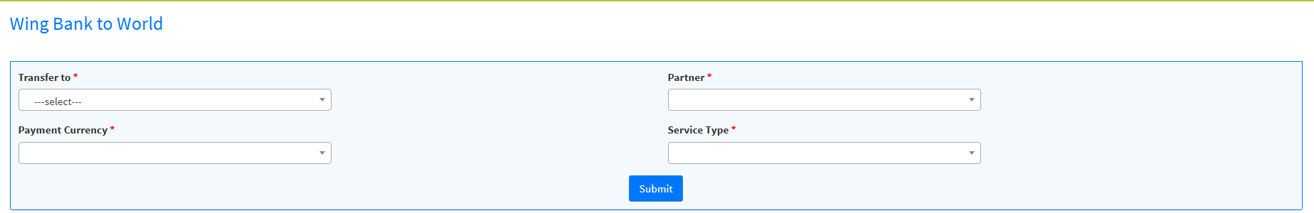
1
Wing Bank To World
Wing Bank To World is used for International Transfer, it support multiple parnters
Click on Money transfer -> Wing Bank to World
Select “Transfer to”, “Partner”, “Payment Currency”, “Service Type”
Click on submit and it will dynamic generate input that required from each partner (each partner has different input)
Enter required input
Click submit

Slide 23
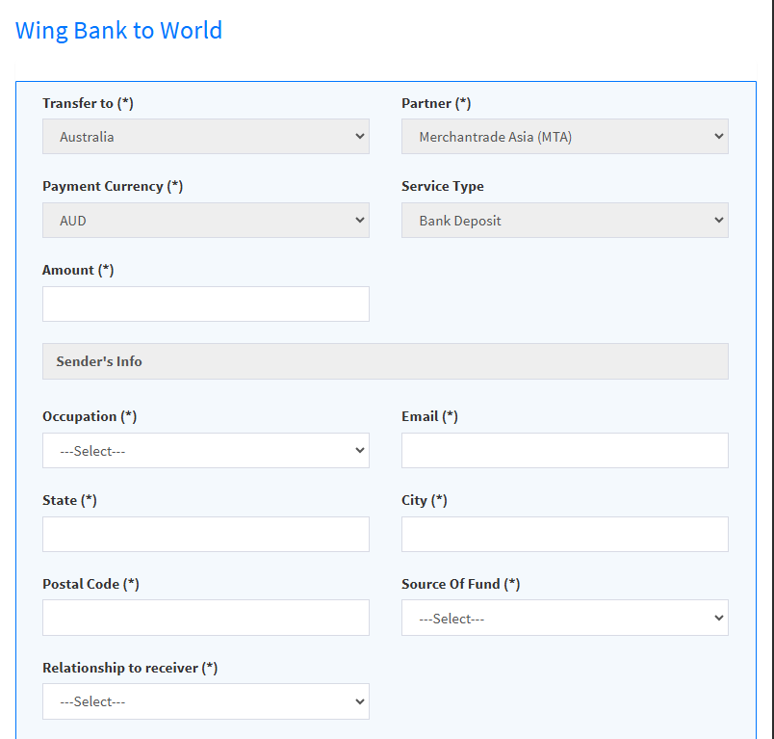
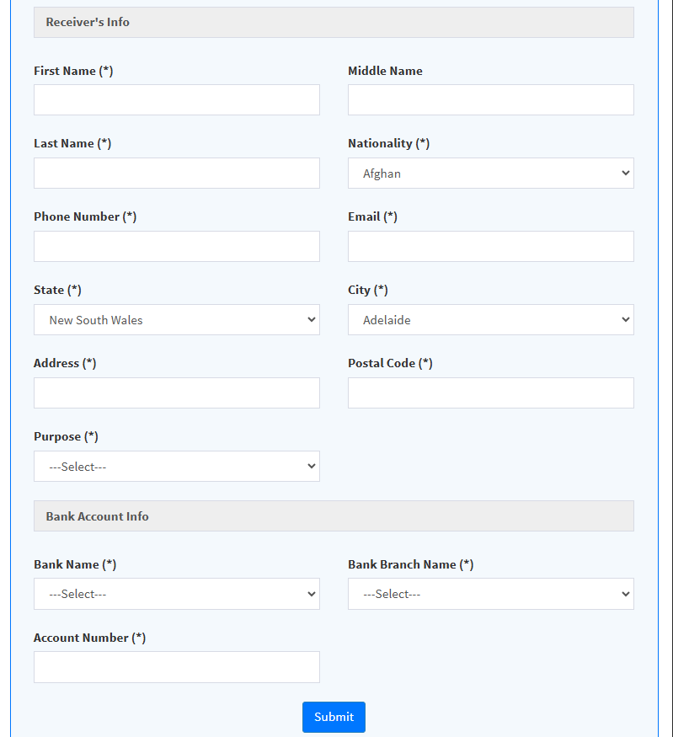
1
Wing Bank to World

Slide 24
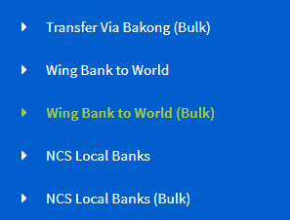
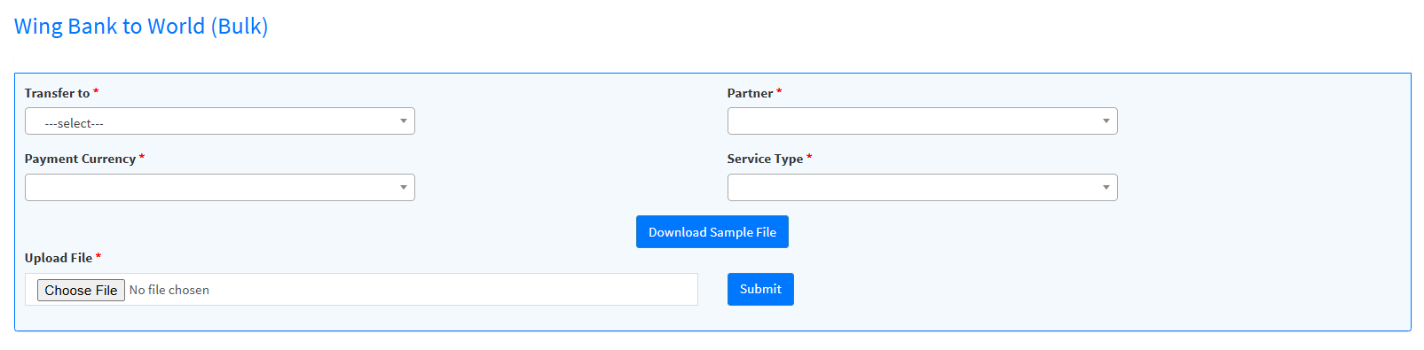
1
Wing Bank to World Bulk
Wing Bank To World is used for International Transfer, it support multiple parnters
Click on Money transfer -> Wing Bank to World Bulk
Select “Transfer to”, “Partner”, “Payment Currency”, “Service Type”
Click on “Download Sample File) and it will dynamic generate input that required from each partner (each partner has different input)
After filled info, upload file
Click submit

Slide 25
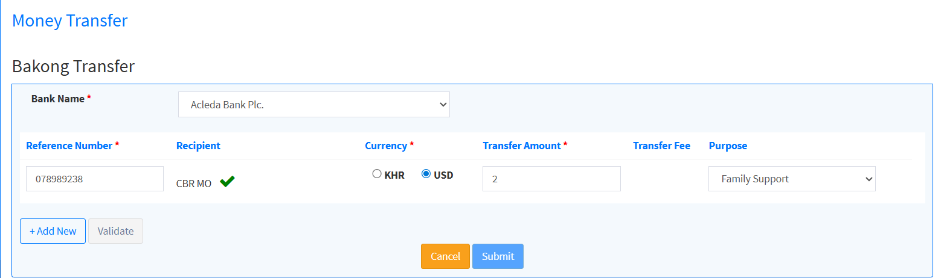
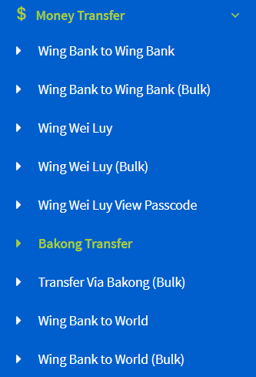
Bakong Transfer
2
3
4
4
1
Bakong transfer
Click on Money transfer -> Wing Wei luy Bulk
Select bank
Enter required data
Click on validate
Click on submit

Slide 26
Transfer Via Bakong (Bulk)
Transfer via Bakong Bulk
Click on Money transfer -> Transfer Via Bakong (Bulk
Select Bank
Choose Upload File
Click Submit
After review click submit again

Slide 27
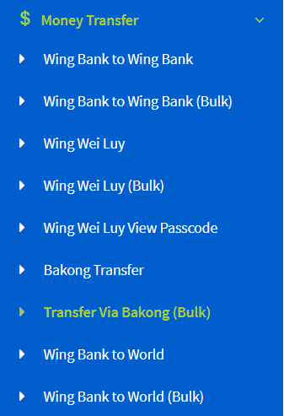
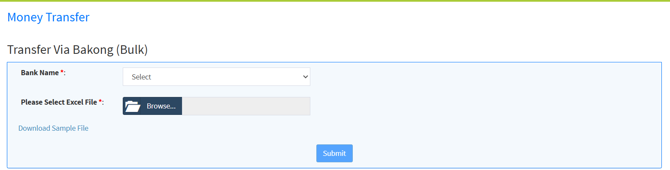
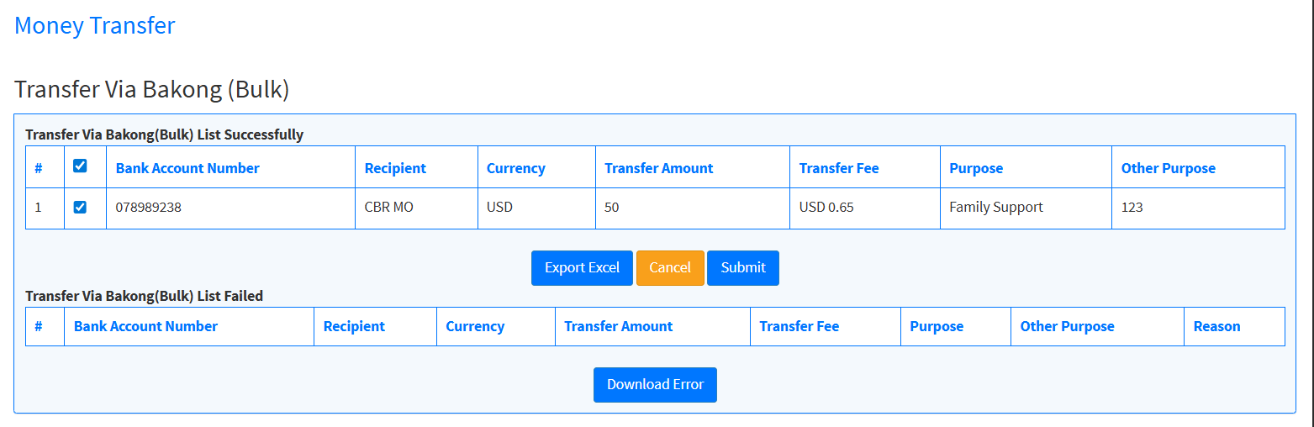
Bakong Bulk
2
3
4
1
5

Slide 28
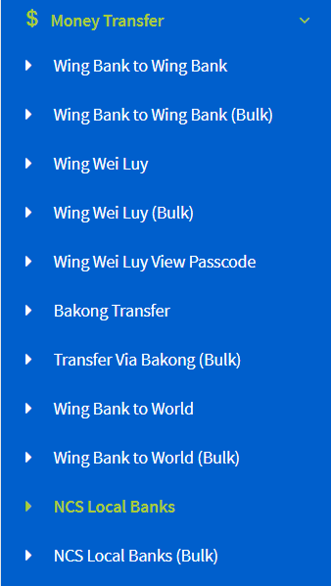
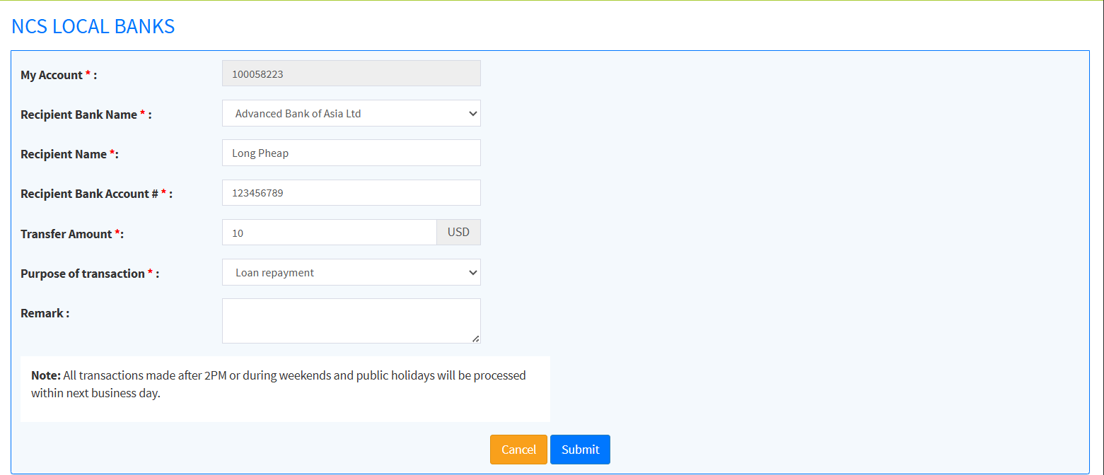
NCS Local Banks
Ncs Local Banks
Click on Money transfer -> Ncs Local Banks
Enter required data
Click on submit
2
1
3

Slide 29
NCS Local Bank Bulk
Ncs Local Bank Bulk
Click on Money transfer -> Ncs Local Bank Bulk
Choose Upload File
Click Submit
After review click submit again

Slide 30
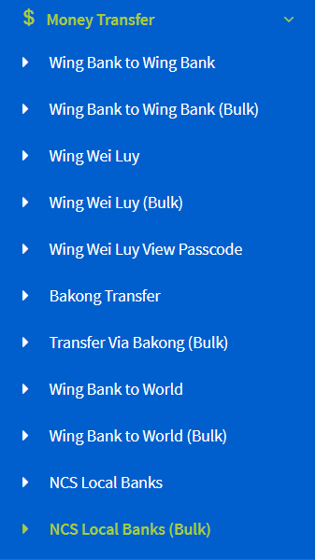
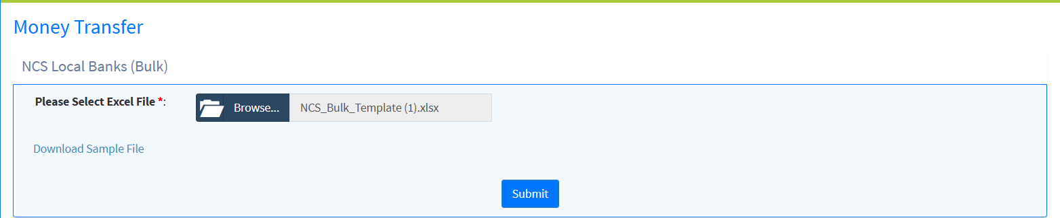
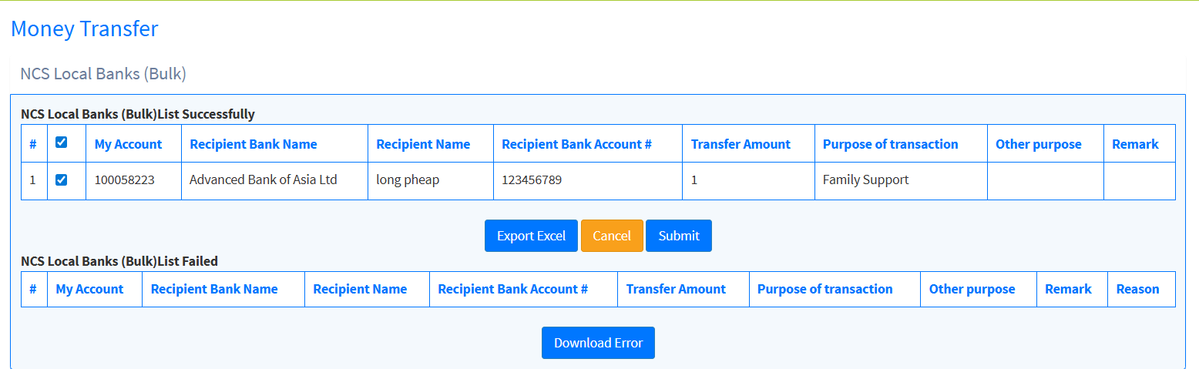
NCS Bulk Upload
2
3
4
1

Slide 31
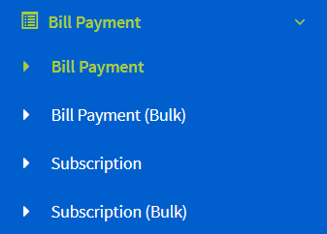
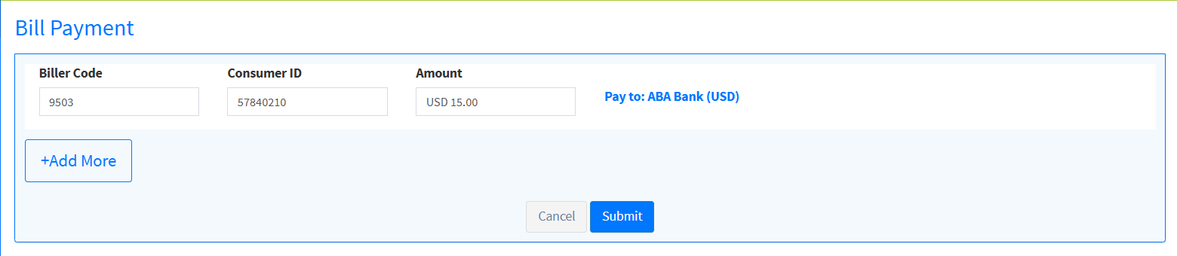
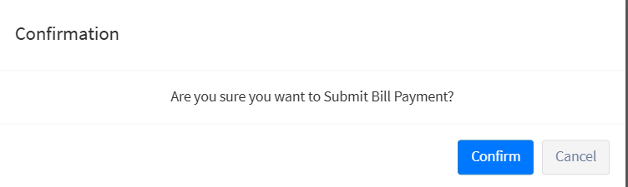
BillPayment
1
2
3
Bill Payment
Click on Bill Payment-> Bill Payment
Enter required data
Click on submit
Click Confirm
4

Slide 32
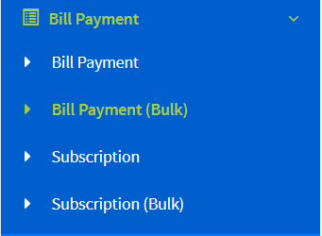
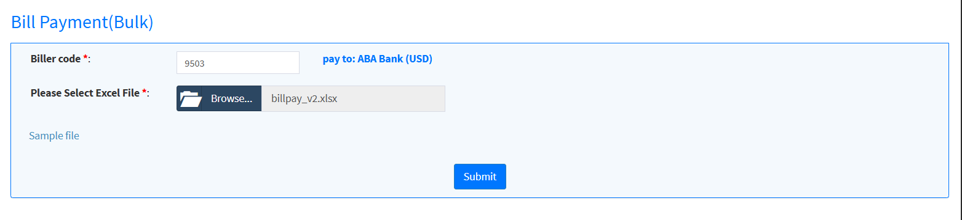
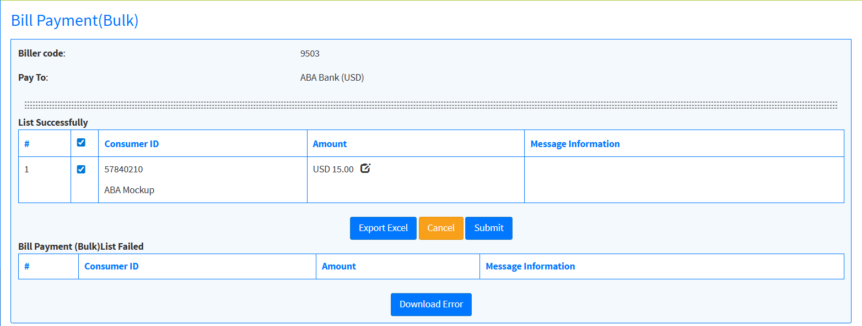
1
BillPayment Bulk
Bill Payment Bulk
Click on Money transfer -> Wing Wei luy Bulk
Enter Biller Code
Choose Upload File
Click Submit
After review click submit again

Slide 33

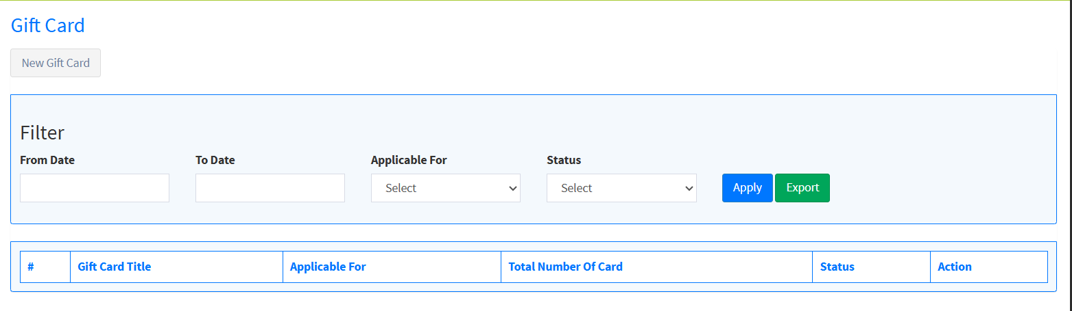
1
Gift Card
The Gift Card feature allows partners to create cards that can be given to customers, which can then be used to purchase fuel at partner stations
Click on Gift Card Management-> Gift Card
Click On New Gift Card
Enter required data
Click on submit
Click Confirm

Slide 34
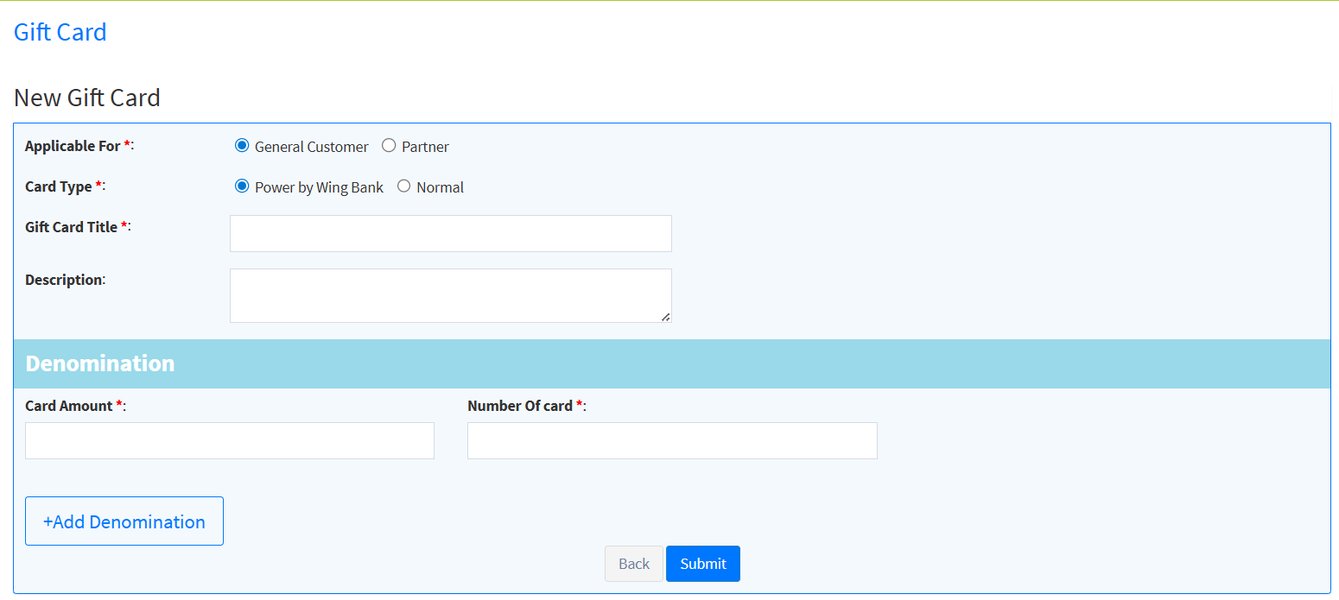

1
Gift Card
Applicable for:
General Customer: For individual customers.
Partner: For companies.
Card Type:
Powered by Wing Bank: For general customers. The physical card will be labeled with “Powered by Wing Bank”.
Normal: Will not have the label. Used when a gas station creates a card for another bank

Slide 35



Fleet card Management
1
2
Fleet card management
Click on Fleet card management -> Card Registration
Enter required data
Click on submit
1

Slide 36


Settlement
Settlement is used for transferring cash to their own Bank
Click on Gift Settlement Request
Click On New Request
Enter required data
Click on submit
1
2

Slide 37

Settlement
3
4

Slide 38


Report
1
Report
Click on Reports -> Reconciliation Report
Select Date Range& Report Type
Click Generate
You can view or Download by clicking export
2
3

Slide 39

Report
4

Slide 40
សូមអរគុណ!

